Slide 1
Software Design for Cloud 2_2
Python Programming
Lecture 2
Multiple Inheritance

Slide 2
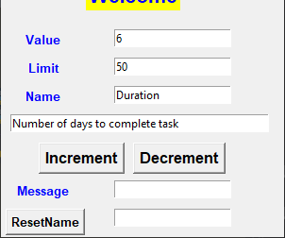
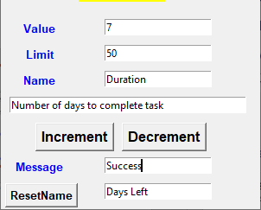
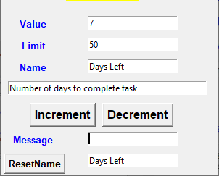

Slide 3
Base Classes
class Counter:
def __init__(self, val):
self._value = val
def setValue(self,val):
self._value=val
def getValue(self):
return self._value
def decrement(self):
if (self._value>0):
self._value -= 1
return True
else:
return False
class Task:
def __init__(self, name, descr):
self._name = name
self._description=descr
def setDescription(self,descr):
self._description=descr
def getDescription(self):
return self._description
def getName(self):
return self._name

Slide 4
Multiple Inheritance
class TaskCounter (Counter,Task):
def __init__(self, val, lim, name, descr):
Counter.__init__(self, val)
Task.__init__(self,name,descr)
self.limit = lim
def increment(self):
if (self._value < self.limit):
self._value += 1
return True
else:
return False
def getLimit(self):
return self.limit

Slide 5
Client
c1=TaskCounter(6,50, "Duration", "Number of days to complete task")
value = c1.getValue() # from Counter
limit = c1.getLimit() # TaskCounter
c1.getName() # Task
c1 has 5 attributes: value, name, description, limit
c1 has 8 methods (all methods Counter, Task, TaskCounter)

Slide 6
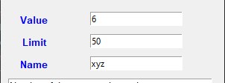

What if we add a getName method to Counter also
class Counter:
:
def getName(self):
return “xyz”;
class TaskCounter (Counter,Task):
class TaskCounter (Task, Counter):
class Task:
:
def getName(self):
return self._name

Slide 7
Resolving Ambiguity Multiple Inheritance
class TaskCounter (Counter,Task):
c1.getName() # calls Counter version
class TaskCounter (Task,Counter):
c1.getName() # calls Task version
//In this send case could use: Counter.getName(c1)
Use Carefully!

Slide 8
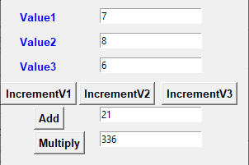
Ex221
Pair______________________
value2 (int) # protected
value3 (int) # protected_______
__init__(int,int)
incrValue2()
int getValue2()
incrValue3()
int getValue3()
Single
-------------------------------------
value1 (int) # protected
--------------------------------------
__init__(int)
incrValue1()
int getValue1()
Treble
-------------------------------------
--------------------------------------
__init__(int,int,int)
int add()# value1+value2+value3
int multiply()

Slide 9
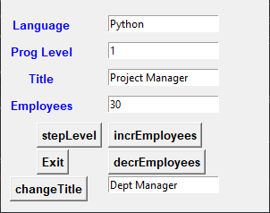
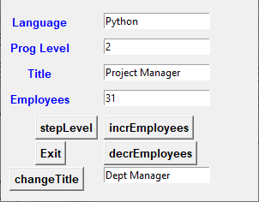

Ex222

Slide 10
Ex222
Manager____________________
title(str) # protected
employees (int) #protected __init__(str,int)
incrementEmployees()
int getEmployees()
str getTitle()
Programmer_______________
_language(str) # protected
_level (int) # protected____
__init__(str, int)
stepProgammingLevel()
int getLevel()
str getLanguage()
ProgrammingManager_______
--------------------------------------
__init__(str,int,str, int)
decrementEmployees()
changeTitle(str)

Slide 11
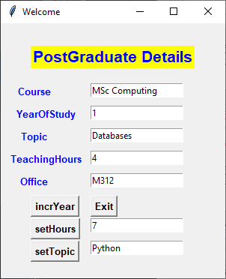
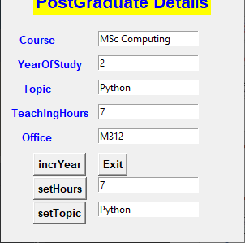
Ex223

Slide 12

Ex223
Lecturer____________________
topic(str) # protected
teachingHours (int) # protected
__init__(str,int)
int getHours()
str getTopic()
setTopic(str)
Student____________________
_course(str) # protected
_yearOfStudy (int) # protected
__init__(str, int)
incrementYear()
int getYear()
str getCourse()
PostGraduate_______________
office (str)
--------------------------------------
__init__(str,int,str, int,str)
setHours(int)
str getOffice()

Slide 13
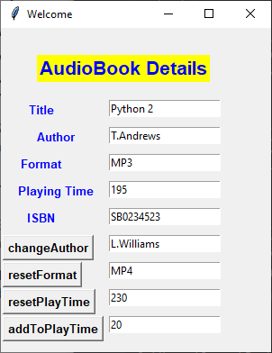
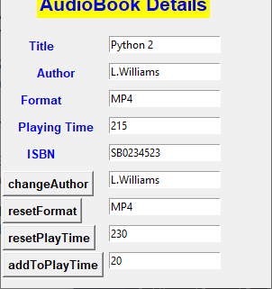
Ex224

Slide 14
Ex224
Audio____________________
format(str) # protected
playtingTime(int) # minutes
__init__(str,int)
int getPlayingTime()
setPlayingTime(int)
str getFormat()
setFormat(str)
Book____________________
_title(str) # protected
_author (int) # protected
__init__(str, str)
str getTitle()
str getAuthor()
setAuthor(str)
AudioBook______________
isbn (str)
--------------------------------------
__init__(str,str,str, int,str)
addToPlayingTime(int)
str getIsbn()

Slide 15
Resolving Ambiguity (RTO)
Some additional Notes

Slide 16
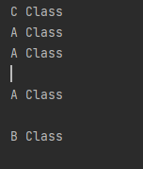
Resolving Ambiguity
class A:
def print(self):
print('A Class')
class B:
def print(self):
print('B Class')
c1 = C()
c1.print()
print()
A.print(c1)
print()
B.print(c1)
class C(A,B):
def print(self):
print('C Class')
super().print()
super().print()

Slide 17
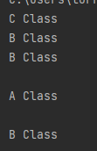
Resolving Ambiguity
class A:
def print(self):
print('A Class')
class B:
def print(self):
print('B Class')
c1 = C()
c1.print()
print()
A.print(c1)
print()
B.print(c1)
class C(B,A):
def print(self):
print('C Class')
super().print()
super().print()

Slide 18
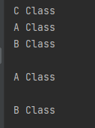
Resolving Ambiguity
class A:
def print(self):
print('A Class')
class B:
def print(self):
print('B Class')
c1 = C()
c1.print()
print()
A.print(c1)
print()
B.print(c1)
class C(A,B):
def print(self):
print('C Class')
A.print(self)
B.print(self)

Slide 19
Resolving Ambiguity
class A:
def print(self):
print('A Class')
class B:
def print(self):
print('B Class')
c1 = C()
c1.print()
print()
A.print(c1)
print()
B.print(c1)
class C(A,B):
def print(self):
print('C Class')
A.print(self)
B.print(self)

Slide 20
Resolving Ambiguity
class A:
def __init__(self, val):
self._value = val
class B:
def __init__(self, val):
self._value = val
class C(A,B):
Note: class C will have only one attribute _value

